Slide 1


Xilin Li
17.Oct.2021

Slide 2

Outline
Executive Summary
Introduction
Methodology
Results
Conclusion
Appendix

Slide 3
Executive Summary
Summary of methodologies
1. Data collection
2. Data wrangling
3. EDA with data visualization
4. EDA with SQL
5. Building an interactive map with Folium
6. Building a Dashboard with Plotly Dash
7. Predictive analysis (Classification)
Summary of all results
1. Exploratory data analysis results
2. Interactive analytics demo in screenshots
3. Predictive analysis results

Slide 4
Introduction
Project background and context
We predicted whether the Falcon 9 first stage will land successfully. SpaceX advertises Falcon 9 launches on its website, with a cost of 62 million dollars; other provider cost 165 million dollars each, much of the savings is because SpaceX can reuse the first stage rocket. Therefore, if we can determine if the first stage rocket will land, we can determine the cost of a launch. This information can be used if an alternate company wants to bid against SpaceX for a rocket launch.
Problems you want to find answers
What influences if the rocket will land successfully?
The effect each relationship with certain rocket variables will impact in determining the success rate of a successful landing.
What conditions does SpaceX have to achieve to get the best results and ensure the best rocket success landing rate.

Slide 5


Slide 6
Methodology
Executive Summary
Data collection methodology:
SpaceX Rest API
Web scrapping from Wikipedia
Perform data wrangling
One Hot Encoding data fields for Machine Learning and dropping irrelevant columns
Perform exploratory data analysis (EDA) using visualization and SQL
Plotting: Scatter Graphs, Bar Graphs to show relationships between variables to show patterns of data
Perform interactive visual analytics using Folium and Plotly Dash
Perform predictive analysis using classification models
How to build, tune, evaluate classification models

Slide 7
Data Collection
Describe how data sets were collected.
The data is collected from the SpaceX REST API, and the API will give us data about launches, including information about the rocket used, payload delivered, launch specifications, landing specifications, and landing outcome.
Another data is collected from Wikipedia using BeautifulSoup.
You need to present your data collection process use key phrases and flowcharts
Use SpaceX REST API
API returns SpaceX data in JSON
Normalize data into flat data file (.csv)
Get HTML Response from Wikipedia
Extract data using BeautifulSoup
Normalize data into flat data file (.csv)
SpaceX API
Web Scrapping

Slide 8
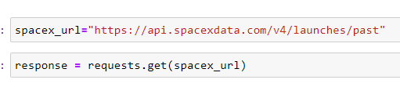
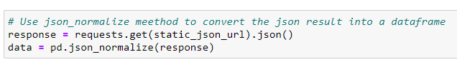
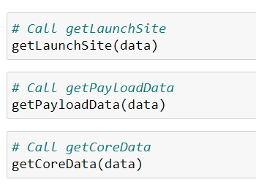
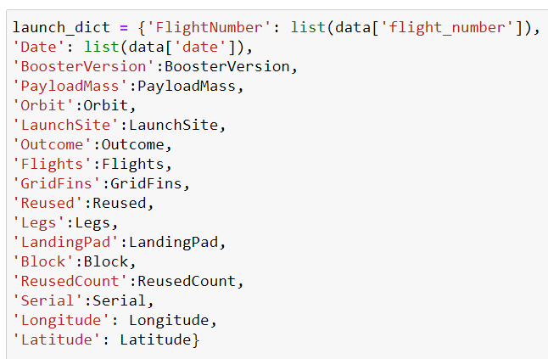
Data Collection – SpaceX API
Present your data collection with SpaceX REST calls using key phrases and flowcharts
Add the GitHub URL of the completed SpaceX API calls notebook (must include completed code cell and outcome cell), as an external reference and peer-review purpose
https://github.com/Simon170624/Winning-Space-Race-with-Data-Science

Slide 9
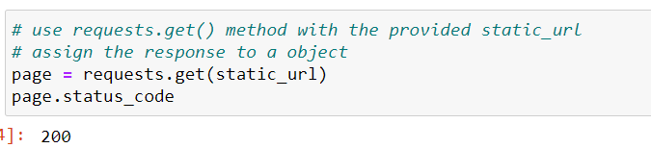
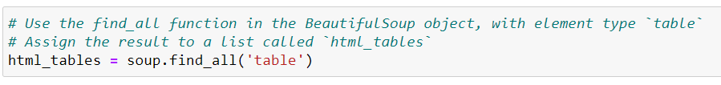
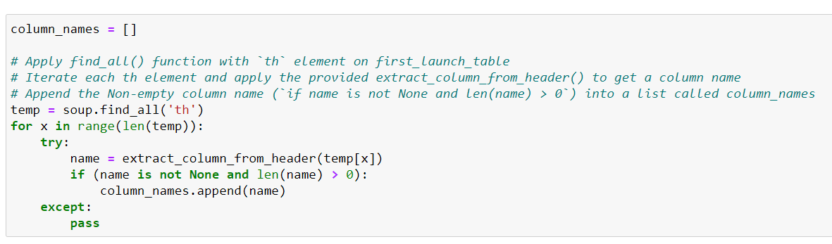
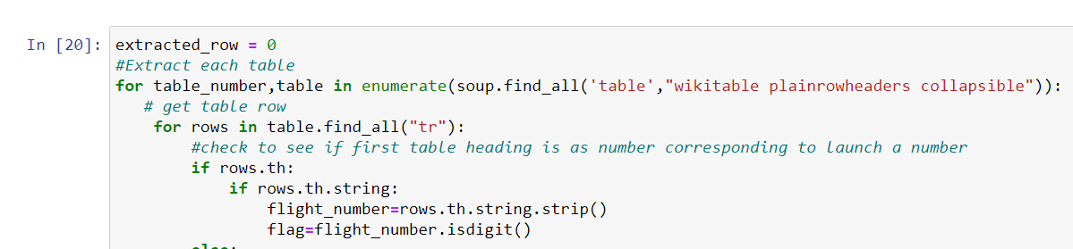
Data Collection - Scraping
Present your web scraping process using key phrases and flowcharts
https://github.com/Simon170624/Winning-Space-Race-with-Data-Science

Slide 10
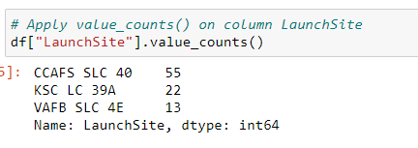
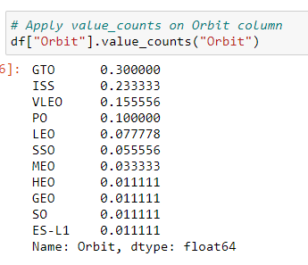
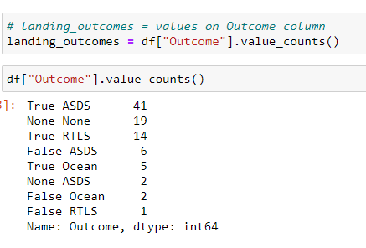
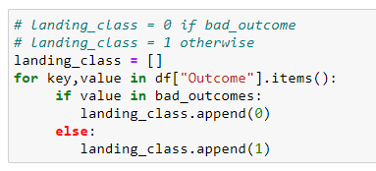
Data Wrangling
Describe how data were processed
1. Data Analysis
2. Calculate the number of launches on each site
3. Calculate the number and occurrence of each orbit
4.Calculate the number and occurrence of mission outcome per orbit type
5. Create a landing outcome label from Outcome column
You need to present your data wrangling process using key phrases and flowcharts
https://github.com/Simon170624/Winning-Space-Race-with-Data-Science

Slide 11
EDA with Data Visualization
Summarize what charts were plotted and why you used those charts
Scatter Graphs show how much one variables is affected by another. The relationship between two variables is called their correlation. Scatter plots usually consist of a larger body of data. Fight Number VS. Payload Mass, Fight Number VS. Launch Site, Payload VS. Launch Site, Orbit VS. Fight Number, Payload VS. Orbit Type, Orbit VS. Payload Mass
Bar Graph makes it easy to compare sets of data between different groups at a glance. The graph represents categories on one axis and a discrete value in the other. The goal is to show the relationship between the two axes. Bar charts can also show big changes in data over time. Mean VS. Orbit
Line Graphs are useful in that they show data variables and trends very clearly and can help to make predictions about the results of data not yet recorded.
https://github.com/Simon170624/Winning-Space-Race-with-Data-Science

Slide 12
EDA with SQL
Using bullet point format, summarize the SQL queries you performed
Connect to the database
Display the names of the unique launch sites in the space mission
Display 5 records where launch sites begin with the string 'CCA’
Display the total payload mass carried by boosters launched by NASA (CRS)
Display average payload mass carried by booster version F9 v1.1
List the date when the first successful landing outcome in ground pad was achieved.
List the names of the boosters which have success in drone ship and have payload mass greater than 4000 but less than 6000
List the total number of successful and failure mission outcomes
List the names of the booster_versions which have carried the maximum payload mass. Use a subquery
List the failed landing_outcomes in drone ship, their booster versions, and launch site names for in year 2015
Rank the count of landing outcomes (such as Failure (drone ship) or Success (ground pad)) between the date 2010-06-04 and 2017-03-20, in descending order
https://github.com/Simon170624/Winning-Space-Race-with-Data-Science

Slide 13
Build an Interactive Map with Folium
Summarize what map objects such as markers, circles, lines, etc. you created and added to a folium map
Mark all launch sites on a map: we took the latitude and longitude coordinates at each launch site and added a Circle Marker around each launch site with a label of the name of the launch site
Mark the success/failed launches for each site on the map: we assigned the dataframe launch_outcomes (failures, success) to classes 0 and 1 with Green and Red markers on the map in a MarkerCluster()
Calculate the distances between a launch site to its proximities: using Haversine’s formula we calculated the distance from the Launch Site to various landmakers to find various trends about what is around the Launch Site to measure patterns. Lines are dran on the map to measure distance to lanmarks.
https://github.com/Simon170624/Winning-Space-Race-with-Data-Science

Slide 14
Build a Dashboard with Plotly Dash
Summarize what plots/graphs and interactions you have added to a dashboard
Graphs: pie chart showing the total launches by a certain site/all sites, display relative proportions of multiple classes of data, size of the circle can be made proportional to the total quantity it represents
Scatter Graph showing the relationship with outcome and payload mass (kg) for the different booster versions, it is the best method to show you a non-linear pattern, the range of data flow, observation and reading are straightforward.
https://github.com/Simon170624/Winning-Space-Race-with-Data-Science

Slide 15
Predictive Analysis (Classification)
Summarize how you built, evaluated, improved, and found the best performing classification model
Building model: load our dataset into Numpy and Pandas, transform data, split our data into training and test data sets, check how many test samples we have, decide which type of machine learning algorithms we want to use, set our parameters and algorithms to GridsearchCV, fit our datasets into the GridsearchCV objects and train our dataset.
Evaluating model: check accuracy for each model, get tuned hyperparameters for each type of algorithms, plot confusion matrix
Improving model: feature engineering, algorithm tuning
Finding the best performing classification model: the model with the best accuracy score wins the best performing model, in the notebook there is a dictionary of algorithms with scores at the bottom of the notebook.
https://github.com/Simon170624/Winning-Space-Race-with-Data-Science

Slide 16
Results
Exploratory data analysis results
Interactive analytics demo in screenshots
Predictive analysis results

Slide 17


Slide 18
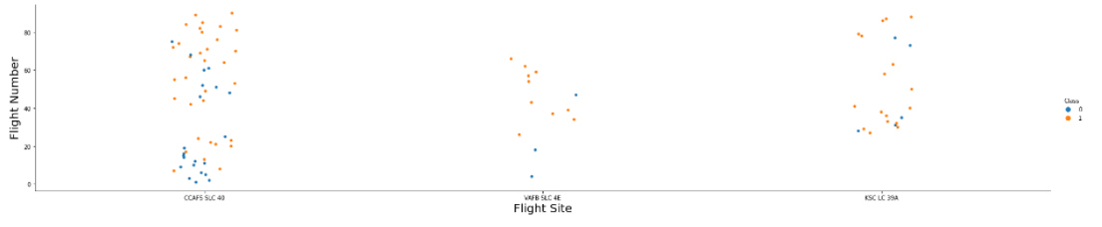
Flight Number vs. Launch Site
Show a scatter plot of Flight Number vs. Launch Site
Show the screenshot of the scatter plot with explanations
The more amount of flights at a launch site the greater the success rate at a launch site.

Slide 19
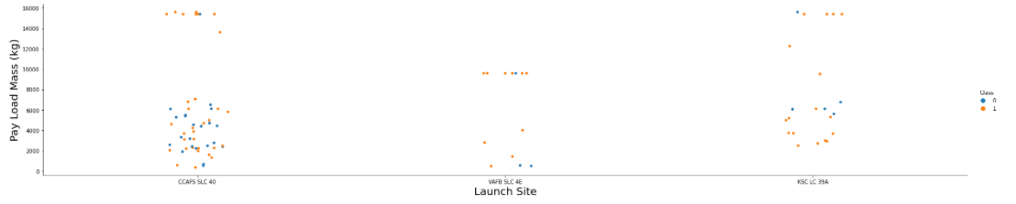
Payload vs. Launch Site
Show a scatter plot of Payload vs. Launch Site
Show the screenshot of the scatter plot with explanations
The greater the payload mass for launch stie CCAFS SLC 40 the higher the success rate for the rocket. There is not quite a clear pattern to be found using this visualization to make a decision if the launch site is dependant on pay load mass for a success launch.

Slide 20
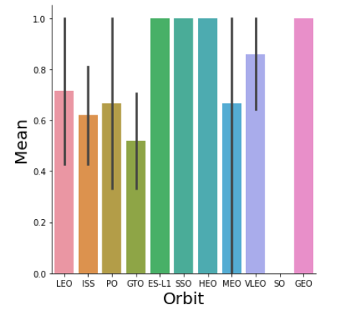
Success Rate vs. Orbit Type
Show a bar chart for the success rate of each orbit type
Show the screenshot of the scatter plot with explanations
Orbit GEO, HEO, SSO, ES-L1 has the best success rate.

Slide 21
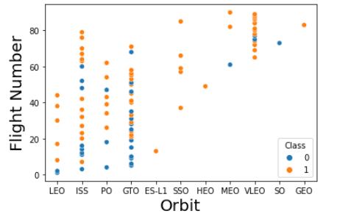
Flight Number vs. Orbit Type
Show a scatter point of Flight number vs. Orbit type
Show the screenshot of the scatter plot with explanations
You should see that in the LEO orbit the success appears related to the number of flights; on the other hand, there seems to be no relationship between flight number when in GTO orbit.

Slide 22
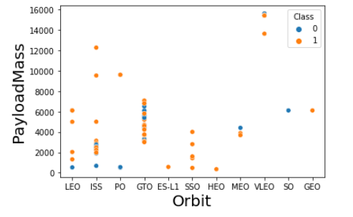
Payload vs. Orbit Type
Show a scatter point of payload vs. orbit type
Show the screenshot of the scatter plot with explanations
You should observe that heavy payloads have a negative influence on GTO orbits and positive on GTO and polar LEO (ISS) orbits.

Slide 23
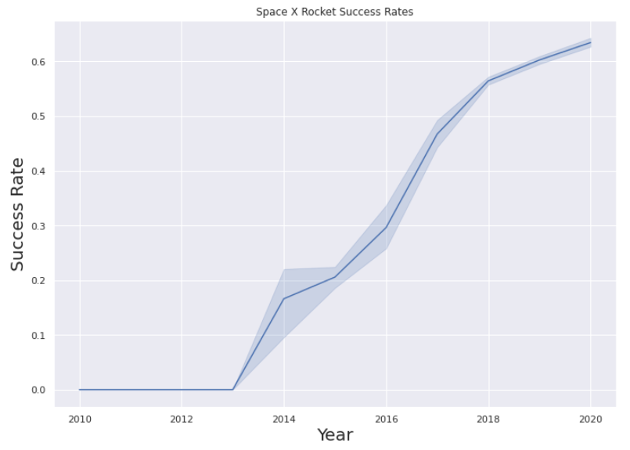
Launch Success Yearly Trend
Show a line chart of yearly average success rate
Show the screenshot of the scatter plot with explanations
You can observe that the success rate since 2013 kept increasing till 2020

Slide 24
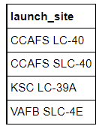
All Launch Site Names
Find the names of the unique launch sites
%sql select Unique(LAUNCH_SITE) from SPACEXDATASET;
Present your query result with a short explanation here
Using the word DISTINCT in the query means that it will only show unique in the LAUNCH_SITE column from SPACEXDATASET

Slide 25
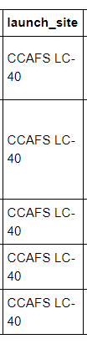
Launch Site Names Begin with 'CCA'
Find 5 records where launch sites begin with `CCA`
%sql SELECT * from SPACEXDATASET where (LAUNCH_SITE) LIKE 'CCA%' LIMIT 5;
Present your query result with a short explanation here
Using the word LIMIT 5 in the query means that it will only show 5 records from SPACEXDATASET and LIKE keyword has a wild card with the words ‘CCA%’ the percentage in the end suggests that the launch_site name must start with CCA

Slide 26
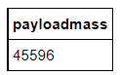
Total Payload Mass
Calculate the total payload carried by boosters from NASA
%sql select sum(PAYLOAD_MASS__KG_) as payloadmass from SPACEXDATASET WHERE customer = 'NASA (CRS)';
Present your query result with a short explanation here
Using the function SUM summates the total in the column payload_mass_kg_. The where clause filters the dataset to only perform calculations on customer NASA (CRS)

Slide 27
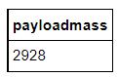
%sql select avg(PAYLOAD_MASS__KG_) as payloadmass from SPACEXDATASET where Booster_Version = 'F9 v1.1';
Average Payload Mass by F9 v1.1
Calculate the average payload mass carried by booster version F9 v1.1
%sql select avg(PAYLOAD_MASS__KG_) as payloadmass from SPACEXDATASET where Booster_Version = 'F9 v1.1';
Present your query result with a short explanation here
Using the function AVG works out the average in the column PAYLOAD_MASS__KG_. The where clause filters the dataset to only perform calculate on Booster_Version = 'F9 v1.1’.

Slide 28
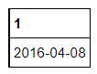
First Successful Ground Landing Date
Find the dates of the first successful landing outcome on ground pad
%sql select min(DATE) from SPACEXDATASET where landing__outcome = 'Success (drone ship)';
Present your query result with a short explanation here
Using the function MIN works out the minimum data in the column DATE, the where clause filters the dataset to only perform calculates on landing__outcome = 'Success (drone ship)’.

Slide 29
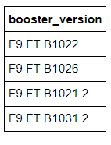
Successful Drone Ship Landing with Payload between 4000 and 6000
List the names of boosters which have successfully landed on drone ship and had payload mass greater than 4000 but less than 6000
%sql select Booster_Version from SPACEXDATASET where landing__outcome = 'Success (drone ship)' and payload_mass__kg_ > 4000 AND payload_mass__kg_ < 6000;
Present your query result with a short explanation here
Selecting only Booster_Version, the where filters the dateset to landing__outcome = 'Success (drone ship)’, the AND clause specifies additional filter conditions payload_mass__kg_ > 4000 AND payload_mass__kg_ < 6000.

Slide 30
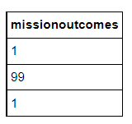
Total Number of Successful and Failure Mission Outcomes
Calculate the total number of successful and failure mission outcomes
%sql select count(MISSION_OUTCOME) as missionoutcomes from SPACEXDATASET GROUP BY MISSION_OUTCOME;
Present your query result with a short explanation here
Count shows the total number, group by shows different kinds.

Slide 31
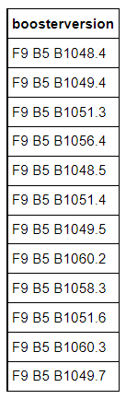
Boosters Carried Maximum Payload
List the names of the booster which have carried the maximum payload mass
%sql select BOOSTER_VERSION as boosterversion from SPACEXDATASET where PAYLOAD_MASS__KG_=(select max(PAYLOAD_MASS__KG_) from SPACEXDATASET);
Present your query result with a short explanation here
Subquery put the maximum payload mass, select BOOSTER_VERSION from SPACEXDATASET, and where evaluates PAYLOAD_MASS__KG_= max value.

Slide 32
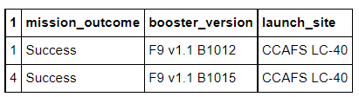
2015 Launch Records
List the failed landing_outcomes in drone ship, their booster versions, and launch site names for in year 2015
%sql SELECT MONTH(DATE),MISSION_OUTCOME,BOOSTER_VERSION,LAUNCH_SITE FROM SPACEXDATASET where landing__outcome = 'Failure (drone ship)' and EXTRACT(YEAR FROM DATE)='2015';
Present your query result with a short explanation here
where filters landing__outcome = 'Failure (drone ship)' and EXTRACT(YEAR FROM DATE)='2015’, and select shows information

Slide 33
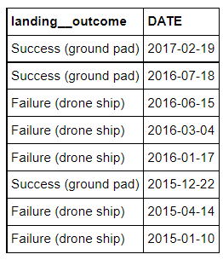
Rank Landing Outcomes Between 2010-06-04 and 2017-03-20
Rank the count of landing outcomes (such as Failure (drone ship) or Success (ground pad)) between the date 2010-06-04 and 2017-03-20, in descending order
%sql SELECT LANDING__OUTCOME, DATE FROM SPACEXDATASET WHERE (landing__outcome IN ('Failure (drone ship)', 'Success (ground pad)')) AND (DATE BETWEEN '2010-06-04' AND '2017-03-20') ORDER BY DATE DESC;
Present your query result with a short explanation here
Select LANDING__OUTCOME and DATE columns, from SPACEXDATASET, Where filters date between 2010-06-04 and 2017-03-20 and landing__outcome is Failure (drone ship) or Success (ground pad).

Slide 34


Slide 35
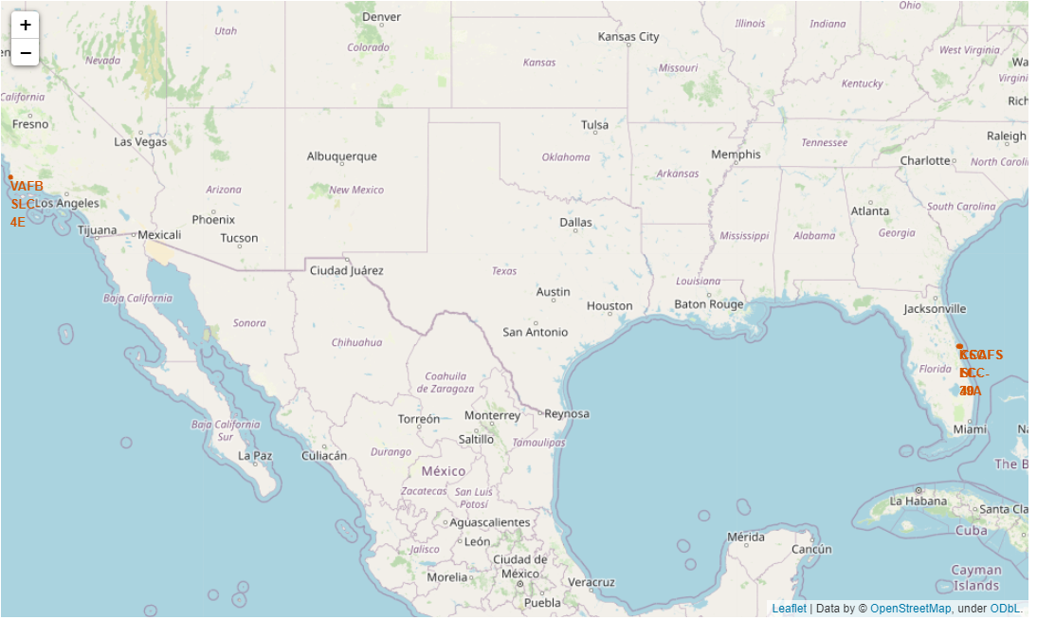
Mark all launch sites on a map
Explore the generated folium map and make a proper screenshot to include all launch sites’ location markers on a global map
Explain the important elements and findings on the screenshot
SpaceX launch sites are in America coasts, Florida, and California.

Slide 36
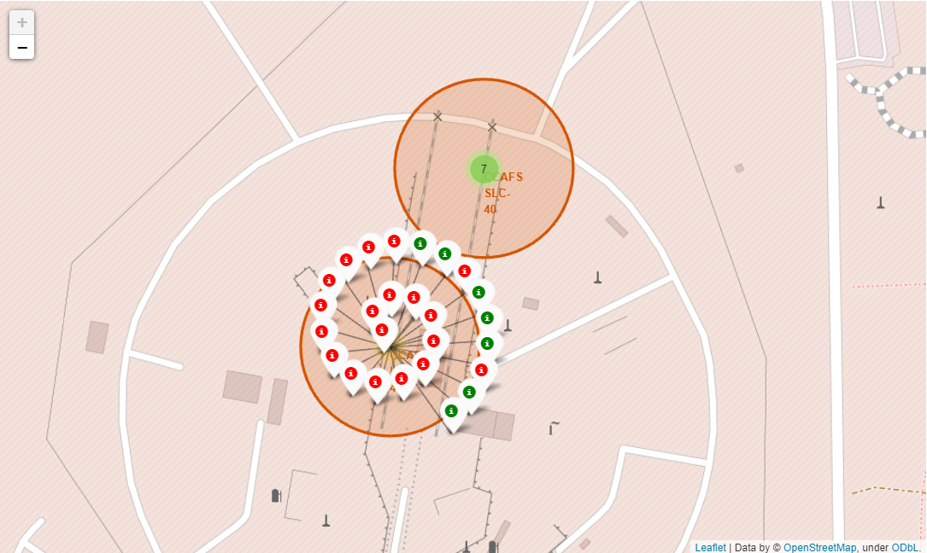
Mark the success/failed launches for each site on the map
Explore the folium map and make a proper screenshot to show the color-labeled launch outcomes on the map
Explain the important elements and findings on the screenshot
Green shows successful and red shows failures.

Slide 37
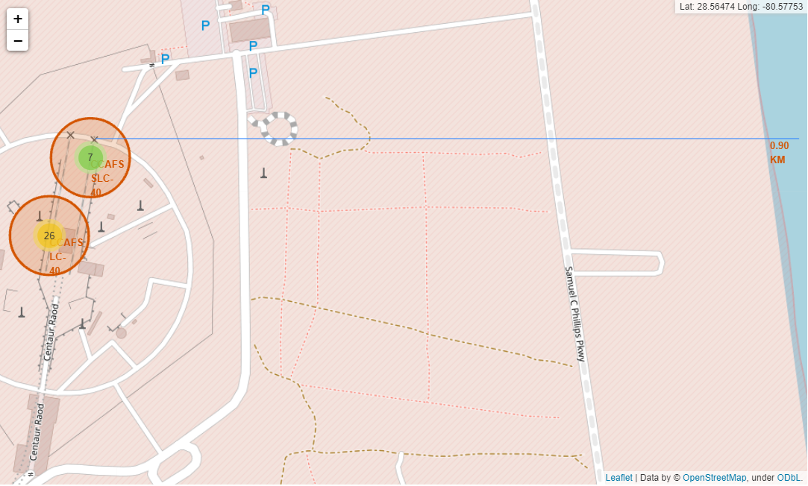
Calculate the distances between a launch site to its proximities
Explore the generated folium map and show the screenshot of a selected launch site to its proximities such as railway, highway, coastline, with distance calculated and displayed
Explain the important elements and findings on the screenshot
For example, showing the distance to coasts

Slide 38


Slide 39
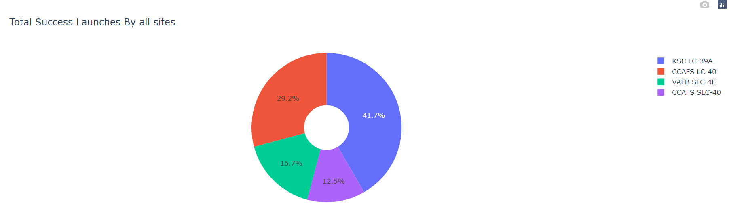
Total Success Launches By all sites
Show the screenshot of launch success count for all sites, in a piechart
Explain the important elements and findings on the screenshot
we can see that KSC LC-39A had the most successful launches.

Slide 40
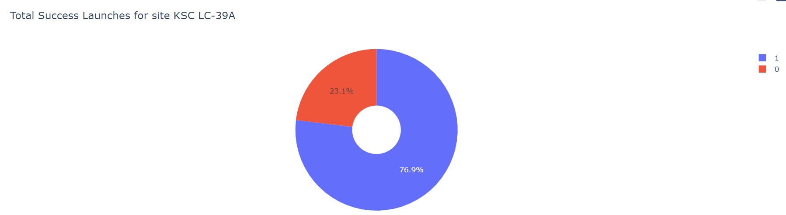
Total Success Launches for site KSC LC-39A
Show the screenshot of the piechart for the launch site with highest launch success ratio
Explain the important elements and findings on the screenshot
KSC LC-39A achieved a 76.9% success rate while a 23.1% failure rate.

Slide 41
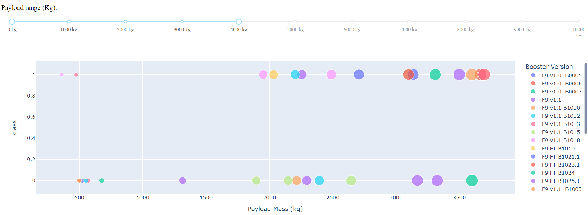
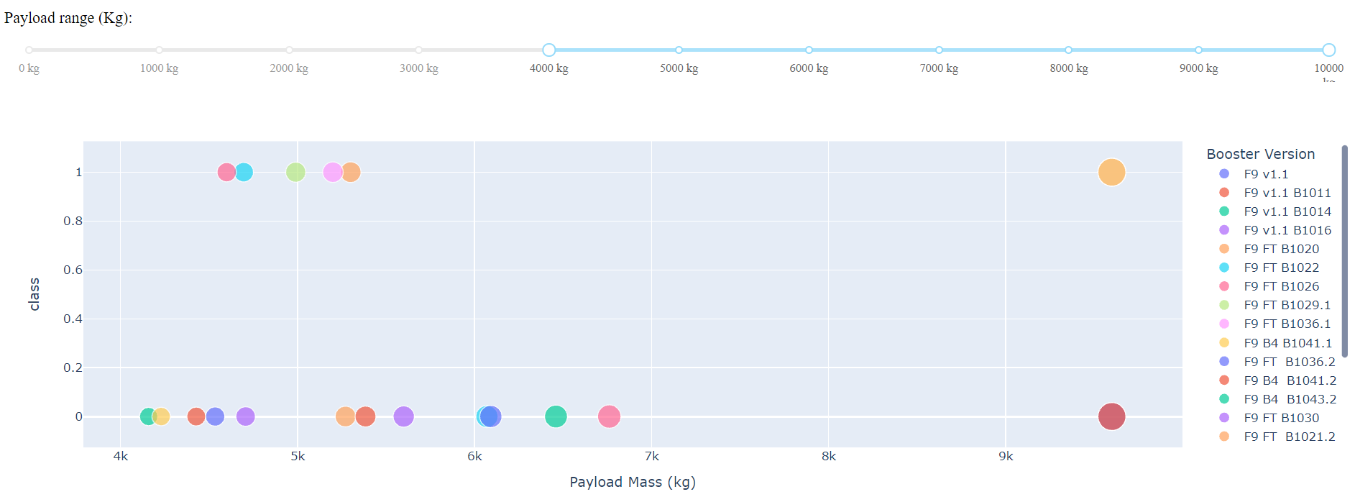
Payload VS. Mass with different paylaod
Show screenshots of Payload vs. Launch Outcome scatter plot for all sites, with different payload selected in the range slider
Explain the important elements and findings on the screenshot, such as which payload range or booster version have the largest success rate, etc.
The success rates for low weighted payloads is higher than the heavy.

Slide 42


Slide 43
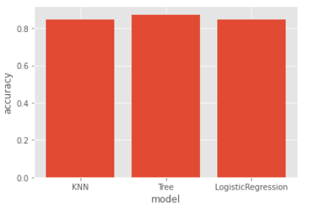
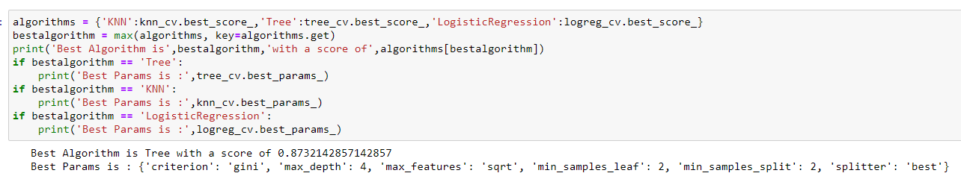
Classification Accuracy
Visualize the built model accuracy for all built classification models, in a bar chart
Find which model has the highest classification accuracy

Slide 44
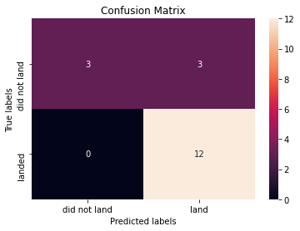
Confusion Matrix
Show the confusion matrix of the best performing model with an explanation
Examining the confusion matrix, we see that Tree can distinguish between the different classes. We see the major problem is false positives.

Slide 45
Conclusions
The Tree is the best for machine learning for this dataset
Low weighted payloads perform better than the heavier payloads
The success rates for SpaceX launches is proportional time in years they will eventually perfect the launches
We can see that KSC LC-39A had the most successful launches from all the sites
Orbit GEO, HEO, SSO, ES-L1 has the best Success Rate.

Slide 46
Appendix
Haversine formula
ADGGoogleMaps Module
Module sqlserver
PythonAnywhere 24/7 dashboard

Slide 47


